Slide 1
PROBABILISTIC ANALYSIS OF CHILDREN’S HANDWRITING USING BAYESIAN AND MARKOV NETWORKS
SUBMITTED BY: ARAVIND KUMAR RAMESH (UB PERSON #: 5013-2610)

Slide 2
OVERVIEW
Abstract
Dataset
Missing Value Imputation
Dataset Visualization
Measuring similarity with Benchmark
Entropy
KL Divergence
Correlation
K2 Algorithm
Bayesian Inference
Conclusion
Reference

Slide 3
ABSTRACT
Probabilistic graphical models aim to express the conditional dependencies in a structural hierarchical fashion among random variables.
Bayesian networks encode factorized form of the joint probability of all random variables. This property is rather useful in answering probabilistic queries pertaining to the distributions by which the data is represented in the Bayesian network.
Our aim in this project is to explore various ways to construct graph networks based on a certain selection criterion. We begin with total independence between the various Random variables and move to detailing the total dependency among various Random variables
In the process we explore the partial representation of dependency and entail the dependency generating sophistication of the algorithm used to encode the partially true network structures
Consequently we develop inference algorithms to determine the mean and entropy of each distribution and relative entropy between distributions (for this purpose we use samples from the original dataset and the synthesized dataset, which in turn is obtained by sampling our networks)

Slide 4
DATASET
The children's handwriting data, including samples for the same student at different grades, are used for studying the development of handwriting individuality along the time
We study children's handwriting traits' and their developmental trend from the time they begin to learn writing to when the traits are established
Since students are being taught the Zaner Bloser style, we assume the Zaner-Bloser style as our benchmark to understand how the handwriting pattern of child changes with respect to each other.
Here we use both cursive and handprint methods of writing of the word ‘and ‘for comparison. If we compare the means of students during various years we can find a trend that reflects how their writing style is developing.
The entropy of the data points help establish individuality of the student in the sense how a student writes different stokes in the word ‘and’. We can construct a Bayesian network that can tell us the dependencies of various features extracted on the word ‘and’ and point to as a whole class how the writing is similar between different students. The Bayesian network can be constructed using many ways. The method we used is the K2 algorithm.

Slide 5
DATASET[cont]
The children's handwriting data, including samples for the same student at different grades, are used for studying the development of handwriting individuality along the time.
The handwriting data are sampled from a large number of students beginning from 2nd grade to 4th grade. Within this time period, the students either begin to learn or just have learned how to write
Writing samples collected for the same student from different years are examined and studied. The word “and” is chosen because it is one of the few words that children write frequently and repeatedly.
After collection, questioned document examiners (QDEs) manually assign different features to handwriting. These are human evaluators who specifically assign the feature vectors to represent the handwriting by 12 features as shown in Figure 1. Ordinal values are assigned to each feature as {0,1,…,k_{i}-1} with two exceptions: the value -1 represents missing value and 99 shows inconsistency within the collected sample.

Slide 6
MISSING VALUE IMPUTATION
The dataset contains values that are -1 (missing data) and 99 (inconsistent data).
Discarding such data can prove to be very costly. Hence we investigated various missing value imputation technique to fill out these missing data.
We clean up the data by assigning “-1” and “99” in the dataset to NaN (not a number).
We then applied the k-nearest neighbor imputation to the dataset.
The nearest neighbor column is the closest column in Euclidean distance. If the corresponding value from the nearest- neighbor column is also NaN then the next nearest column is used

Slide 7
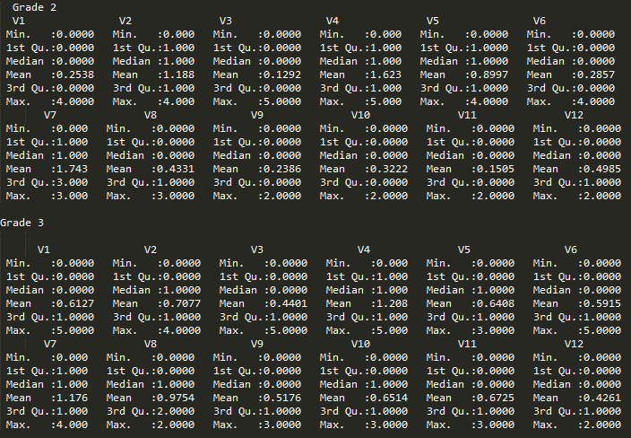
DATASET VISUALIZATION
We use various parameters such as mean and entropy of each feature to better visualize and understand the dependencies that will better help us model Bayesian Network.
FIGURE 1. Mean and Median of features for handprint dataset

Slide 8
DATASET VISUALIZATION [cont]
It is clearly indicated that eventually over the years the students improved their handwriting and were more similar to the reference Zaner-Bloser.
We also observed that the shape of arch of “n” is rounded for handprint as a student progressed from grade 2 to grade 4.
Students tend to orient the staff of “a” more towards the right, and tend to have an equal a-d relationship for both handprint and cursive.
Retracted formation of “d” staff is more prominent in cursive handwriting and the trend of “a” orientation towards the right is also as prominent as in handprint.
Cursive handwriting sports a more overhand style for the formation of “d” initial however this feature has a retracted formation of ‘”d” staff in handprint

Slide 9
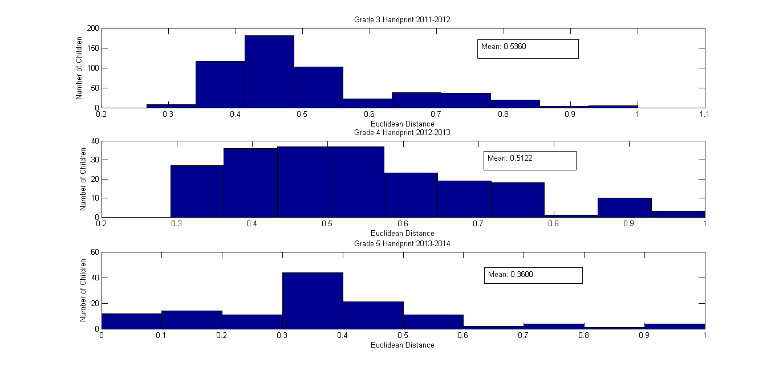
MEASURING SIMILARITY WITH BENCHMARK
FIGURE 2: Similarity of Handprint with Zaner-Bloser Benchmark

Slide 10
ENTROPY
Entropy is a metric to quantify the randomness of a dataset. By analyzing the entropy, we can make conclusion regarding the variation in the behavior of the features as a student advances in their grade.
In same grade, between printed and cursive, students tend to be more similar in “Printed”, which has a higher entropy. This is intuitive because, in 3rd grade, students are writing cursive for the first time but writing printed for the second time.
Grade | F1 | F2 | F3 | F4 | F5 | F6 | F7 | F8 | F9 | F10 | F11 | F12
Grade 3 | 0.42 | 0.273 | 0.245 | 0.344 | 0.381 | 0.339 | 0.291 | 0.213 | 0.235 | 0.337 | 0.249 | 0.412
Grade 4 | 0 | 0 | 0.357 | 0.136 | 0.2 | 0.228 | 0.441 | 0.228 | 0.254 | 0.296 | 0 | 0.335

Slide 11
KL DIVERGENCE
KL Divergence is one of the metrics used to evaluate the “Relative Entropy” across the various datasets. This metrics allows us to understand the relationship among the features as how they vary as the students advance in their academics. The lesser the KL divergence value the more strong is the similarity between the distributions of the given feature.
KL Divergence between 3rd grade Printed and 3rd grade Cursive indicate that feature 9 is very low. This means the feature set of “unusual formations” in cursive and “Symbols” in printed is almost identical. This might also be true because of very few such entries.
Overall, in printed writing, the “number of n arches” feature is the least divergent across grades. So, it may be assumed that students write ‘n’ very similarly than they do ‘a’ and ‘d’. This is in sync with what we inferred from the first point.
Grades | F1 | F2 | F3 | F4 | F5 | F6 | F7 | F8 | F9 | F10 | F11 | F12
3rd Grade Handprint | 6.241 | 0.894 | 2.367 | 0.616 | 1.927 | 0.198 | 11.948 | 2.106 | 0.701 | 2.289 | 0.606 | 0.895
2nd Grade-3rd Grade Handprint | 6.241 | 0.894 | 2.367 | 0.616 | 1.927 | 0.198 | 11.948 | 2.106 | 0.701 | 2.289 | 0.606 | 0.895
3rd Grade- 4th Grade Handprint | 6.313 | 5.819 | 0.297 | 5.049 | 4.113 | 6.944 | 4.371 | 0.702 | 0.6 | 1.494 | 3.726 | 2.597

Slide 12
CORRELATION
The most basic approach to constructing graph is to use the measure of correlation.
We start off by assuming that a node can have at-most two parents.
This is basically done to reduce the number of Bayesian structure that we would have to realize otherwise. When we make this assumption, the process becomes less involved. We begin by computing the correlation using the Pearson’s test.
Pearson’s test is a powerful tool that not just gives us an idea about the correlation that exists between two variables but also the directionality. This is useful while deducing features that are dependent and independent.
After constructing the graph, the conditional probability distribution can be simply computed by the process of counting.
The probabilistic measure is very important when constructing Bayesian networks as this will help us compare the initial reference that we have carried out using the raw dataset and establish the dependencies and independencies between variables.

Slide 13
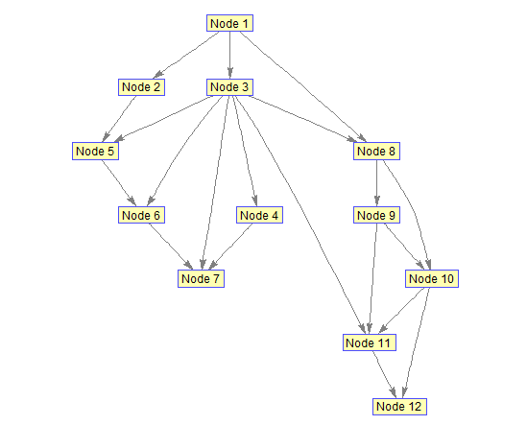
K2
The Precise construction of Bayesian network classifier from database is an NP-hard problem. K2 algorithm can reduce search space effectively, to improve learning efficiencies, but it requires the initial node ordering as the input, which is very limited by the absence of priori information.
We use the Pearson’s test to justify the ordering.
FIGURE 3: Bayesian Network

Slide 14
BAYESIAN INFERENCE
In a Bayesian Networks we’ll encounter situations where we have some evidence, that is, some of the variables are instantiated, and we want to infer something about the probability distribution of some other variables.
The most popular and accurate technique is the exact inference where we analytically compute the conditional probability distribution over the variables of interest.
But sometimes that’s too hard to do, in which case we can use approximate techniques based on statistical sampling.
The most usual inference is a conditional probability query. Given the joint distribution over the variables, we can easily answer my question about the value of a single variable by summing (or marginalizing) over the other variables.
So, in a domain with four variables, A, B, C, and D, the probability that variable D has value d is the sum over all possible combinations of values of the other three variables of the joint probability of all four values.

Slide 15
BAYESIAN INFERENCE [CONT]
We computed the probabilistic queries using the variable elimination method from the Bayesian network that we constructed. The primary and most resourceful probabilistic computation was carried out to understand how many percentage of the total students from a particular grade try to mimic the Zaner Bloser style. The results are as tabulated below:
From the tabulated results we can see that the Grade 3 handwriting for Handprint closely resembles the Zaner Bloser style whereas when it comes to Cursive the same can be observed in Grade 4. There is a significant margin of error here since the variable elimination method is an approximation method used to answer the probabilistic queries
QUERY | HANDPRINT | CURSIVE
GRADE 2/ ZANER BLOSER | 0.2887 | NO DATA AVAILABLE
GRADE 3/ ZANER BLOSER | 0.3855 | 0.3090
GRADE 4/ ZANER BLOSER | 0.3090 | 0.5766
GRADE 5/ ZANER BLOSER | 0.2956 | 0.5422

Slide 16
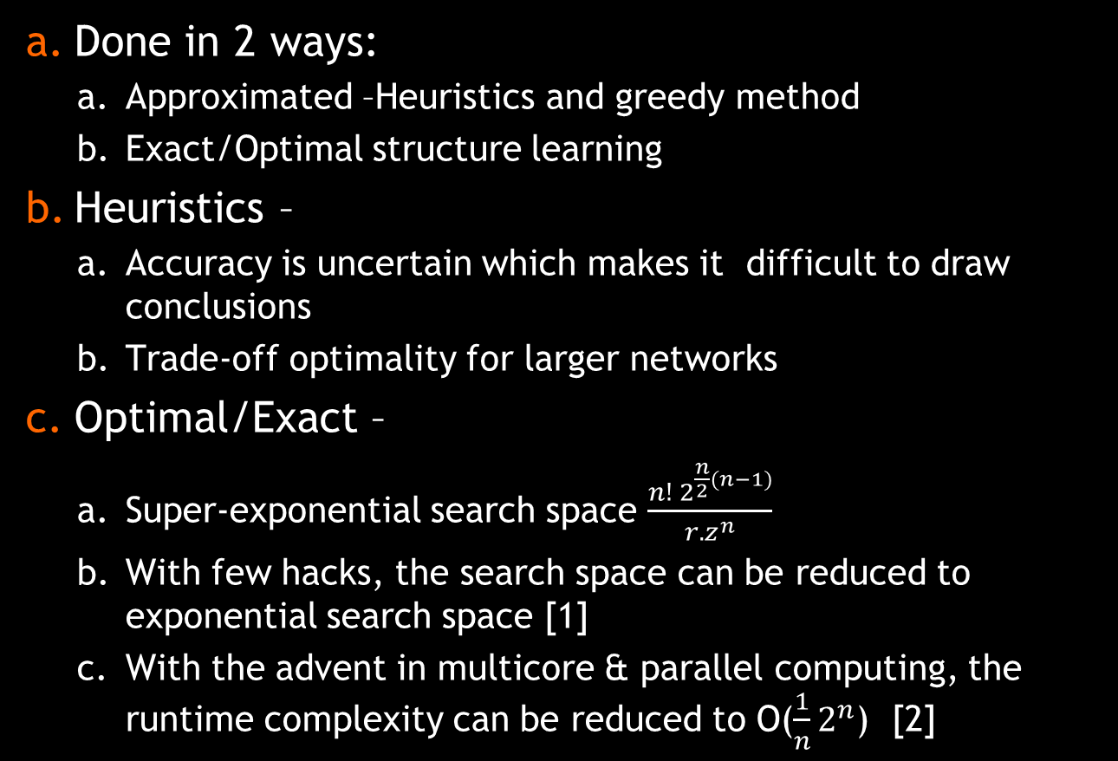
EXACT BAYESIAN STRUCTURE LEARNING
Done in 2 ways:
Approximated –Heuristics and greedy method
Exact/Optimal structure learning
Heuristics –
Accuracy is uncertain which makes it difficult to draw conclusions
Trade-off optimality for larger networks
Optimal/Exact –
Super-exponential search space $\frac{n! 2^{\frac{n}{2}(n−1)}}{r.z^{n}}$
With few hacks, the search space can be reduced to exponential search space [1]
With the advent in multicore & parallel computing, the runtime complexity can be reduced to O($\frac{1}{n}2^{n}$) [2]

Slide 17
OPTIMAL STRUCTURE LEARNING
Sequential algorithm:
Scoring function(s): BIC criterion
F(g,A) : Optimal score for a variable ‘g’ and its predecessor ‘A’
Π(A) – Ordering of elements from set A
Q(Π(A)) – Denote the optimal score of a network on A , which is consistent with Π(A)
Step 1: Compute F(g, ∅) = s(g, ∅) for all g ∈ G.
Step 2: For all A ⊆ G, A ≠ ∅ and all g ∈ G,
Compute F(g, A) as min{s(g, A), min_{a∈A} F(g, A − {a})}.
Step 3: Set M(∅) = ∅.
Step 4: For all A ⊆ G, A ≠ ∅, do the following two steps:
Step 4a: Compute g∗ = arg min_{g∈A}(F(g, A− {g})+Q^{A−{g}}(M(A− {g}))).
Step 4b: For all 1 ≤ i < |A|, set M(A)(i) = M(A − {g∗})(i), and M(A)(|A|) = g∗.
Step 5: return Q^{G}(M(G)).

Slide 18
COMPLEXITY ANALYSIS
Complexity analysis: The above algorithm takes the advantage of the dynamic programming strategy which exploits the optimal substructure property.
Step 1 & step2: O (n.2^{n})
Step 3 & Step 4: O (n.2^{n})
Overall Complexity: O (n.2^{n})

Slide 19

PARALLEL VERSION
Brings the computational complexity to O($\frac{1}{n}2^{n}$) at no extra space complexity than the sequential algorithm.
Dynamic programming strategy applied on the lattice structure formed by the partial order of the power set of X.
Lattice L is viewed as a directed graph (V,E), where V = 2^{X} , is naturally divided into levels where each level l contains all the subsets of size l.
Algorithm was formalized by mapping the nodes to processors and the having edges represent communication if the incident nodes are assigned to different processors.
Q∗(A),π∗(A),and a total of (n − l) functions are computed at node A. All of these values need to be sent along each of the outgoing edges.
On an outgoing edge to node A ∪ {X_{i}}, the F(X_{i} , A) value is used in computing Q∗(A ∪ {Xi }), and the remaining F(X_{k}, A) (X_{k}∉ A and X_{k} ≠ X_{i}) values are used in computing F(X_{k}, A ∪ {X_{i} }) values at node A ∪ {X_{i} }.
Each level in the lattice can be computed concurrently, with data flowing from one level to the next.

Slide 20
MARKOV NETWORK
Bayesian Networks can represent independence constraints that Markov networks cannot.
Bayesian Network also takes into account the directionality of the individual parameters that is found using the chi-squared test.
Markov Networks come under the undirected graphs and can represent few independence constrains that Bayesian Networks cannot.
The challenge here is constructing the Markov Network given the Bayesian Network. This can be done by the process of moralization.
For each variable, we add an edge between the variable and its parents and add another edge between all the parents of the variables.
A Bayesian networks G is moral if it contains no immoralities i.e for any pairs of variables X,Y that share a child, there is a covering edge between two variables.

Slide 21
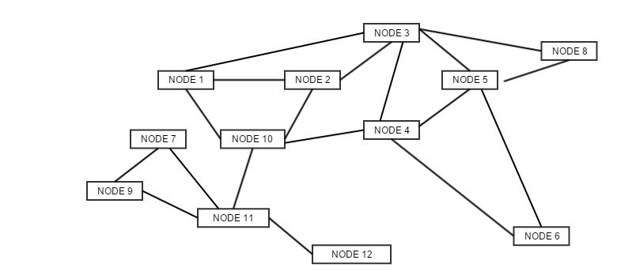
MARKOV NETWORK [CONT]
FIGURE 4: Markov Network for Grade 3 Handprint

Slide 22
CONCLUSION
From the Bayesian network constructed, we observe that some of our initial intuition about dependencies were indeed true. We observe that Feature 5 (shape of arch of “n”) is dependent on Feature 3 (Stroke of “n”)
Number of Stroke in “d” and formation of “d” staff are correlated.
Number of Strokes in “a” and formation of “a” staff are also dependent
Initial Stroke of “d” has a significant effect on “a-d” relationship.
WE can infer that a-d, n-d and a-n relationships are not dependent on how we write the letters individually but are somewhat only interdependent on each other. This is actually in sync with what we had inferred from the dataset initially, i.e., the prior knowledge that a-d, a-n and n-d relationships might be related to each other because they are about joining two letters

Slide 23
REFERENCES
[1] S. Ott, S. Imoto, and S. Miyano, “Finding optimal models for small gene networks.,” in Pacific Symposium on Biocomputing (PSB), 2004, pp. 557–567.
[2] B. O’Gorman and a Perdomo-Ortiz, “Bayesian Network Structure Learning Using Quantum Annealing,” arXiv Prepr. arXiv …, pp. 3546–3551, 2014.
[3] O. Nikolova, J. Zola, and S. Aluru, “Parallel Globally Optimal Structure Learning of Bayesian Networks,” J. Parallel Distrib. Comput., vol. 73, no. 8, pp. 1039–1048, 2013.
[4] O. Nikolova, “Parallel Algorithms for Bayesian Networks Structure Learning with Applications to Systems Biology,” 2011 IEEE Int. Symp. Parallel Distrib. Process. Work. Phd Forum, pp. 2045–2048, 2011.
[5] M. Puri, S. N. Srihari, and Y. Tang, “Bayesian network structure learning and inference methods for handwriting,” Proc. Int. Conf. Doc. Anal. Recognition, ICDAR, pp. 1320–1324, 2013.
[6] Y. Tang and S. N. Srihari, “Efficient and Accurate Learning of Bayesian Networks using Chi-Squared Independence Tests,” Int. Conf. Pattern Recognit., no. Icpr, pp. 2723–2726, 2012.

